Slide 1
Mitobunny --Mitosis detection
Srijeet Chatterjee , Mingxuan Gu, Zhaoya Pan, Wenyu Zhang, Muhammed Umer Raja
June 17, 2019

Slide 2
Introduction
1) Medical use of mitosis(cancer assessment)
2) Traditional method of mitosis detection and its disadvantages(counting, cumbersome, time, money)
3) Our project
Notes:
1) The number of mitotic figures visible in histology sections is an important indicator for cancer screening and assessment
2) the count is performed manually by pathologists, histologists, (This process is cumbersome)

Slide 3
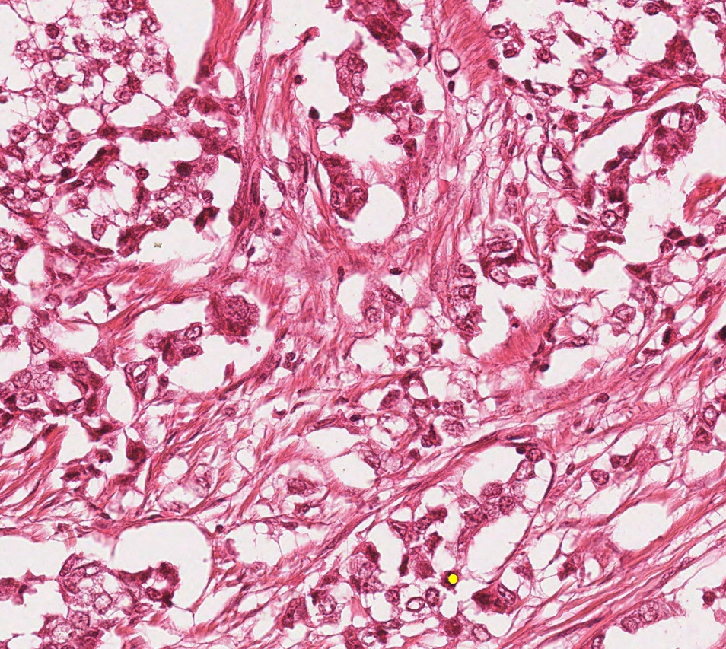
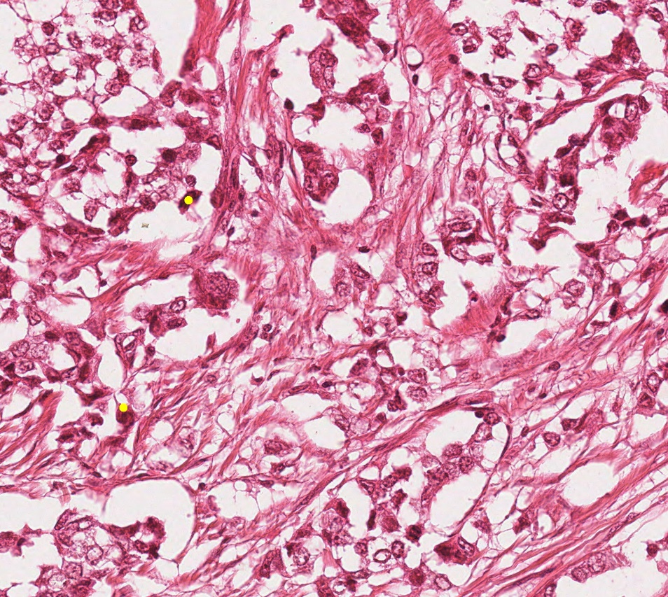
True image of mitosis under microscope
Notes:
Mitotic cell may look alike, and this will make assessments more difficult
A low density of mitosis makes it more labor intensive for a pathologist.

Slide 4
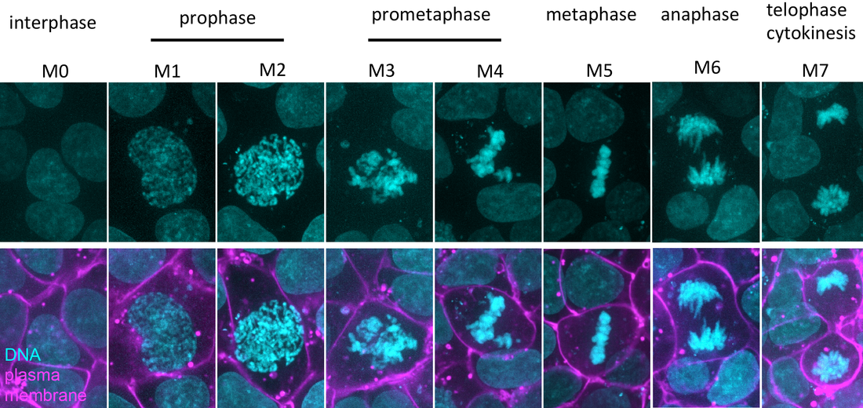
Notes:
differences in staining and
tissue artifacts complicate
this task.
Furthermore, mitotic detection manually often cost 24-96h and this period will be painful for the patients
Because of its importance in determining the severity of the cancer,
the development of automated mitosis detection has become necessary and imperative

Slide 5
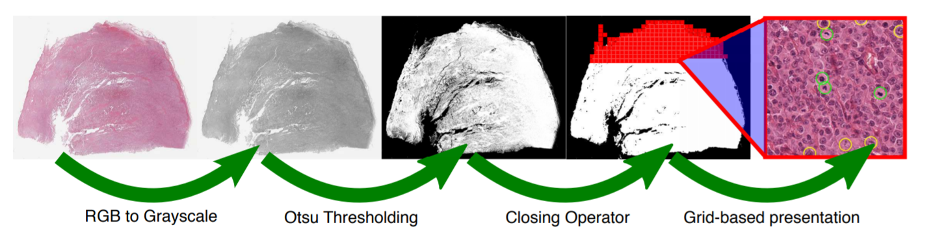
Database
MITOS-ATYPIA-14
TUPAC16

Slide 6
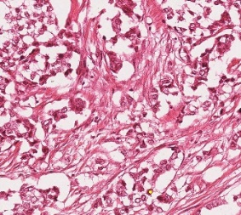
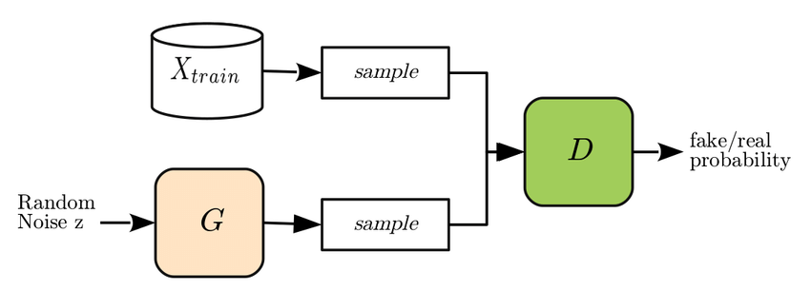


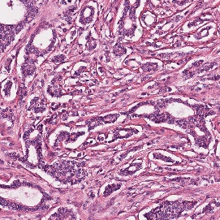
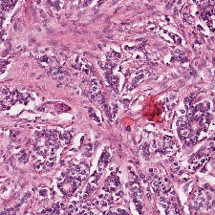
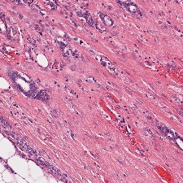
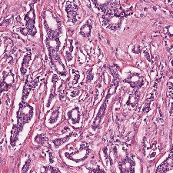
Given data(labeled)
generated data(unlabeled)
generated data(labeled)
Notes:
Because of its importance in determining the
severity of the cancer, the development of automated
mitosis detection has become necessary and critical
Here is our game design overview

Slide 7
Motivation
1) Make mitotic detection more convenient
2) Limited data(GAN)
3) More robust model with more labeled data

Slide 8
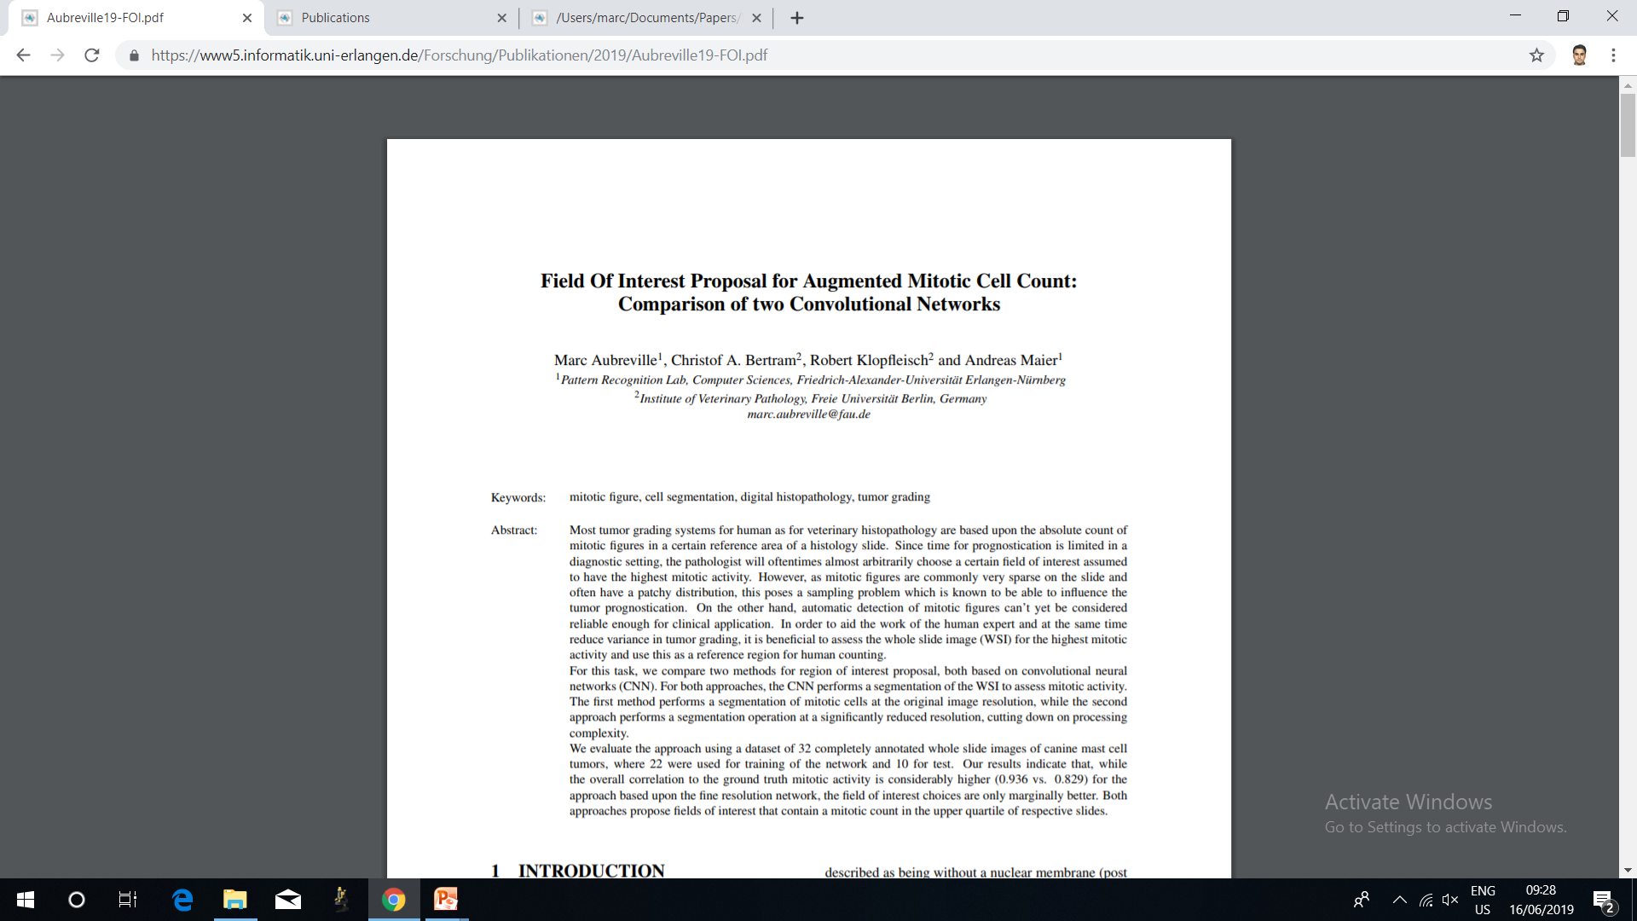
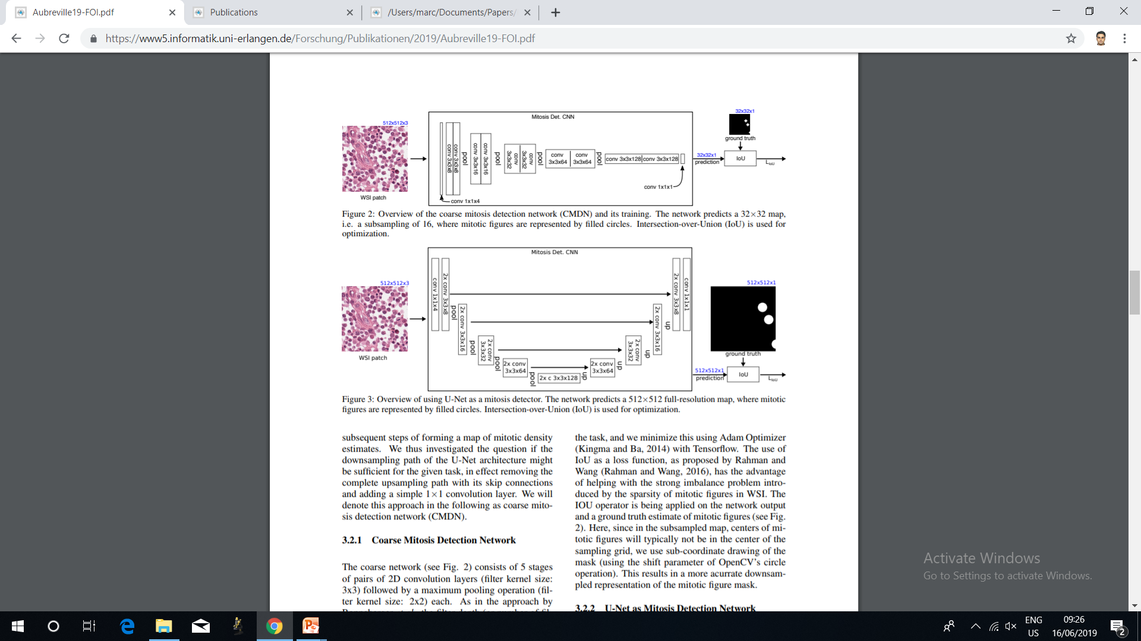
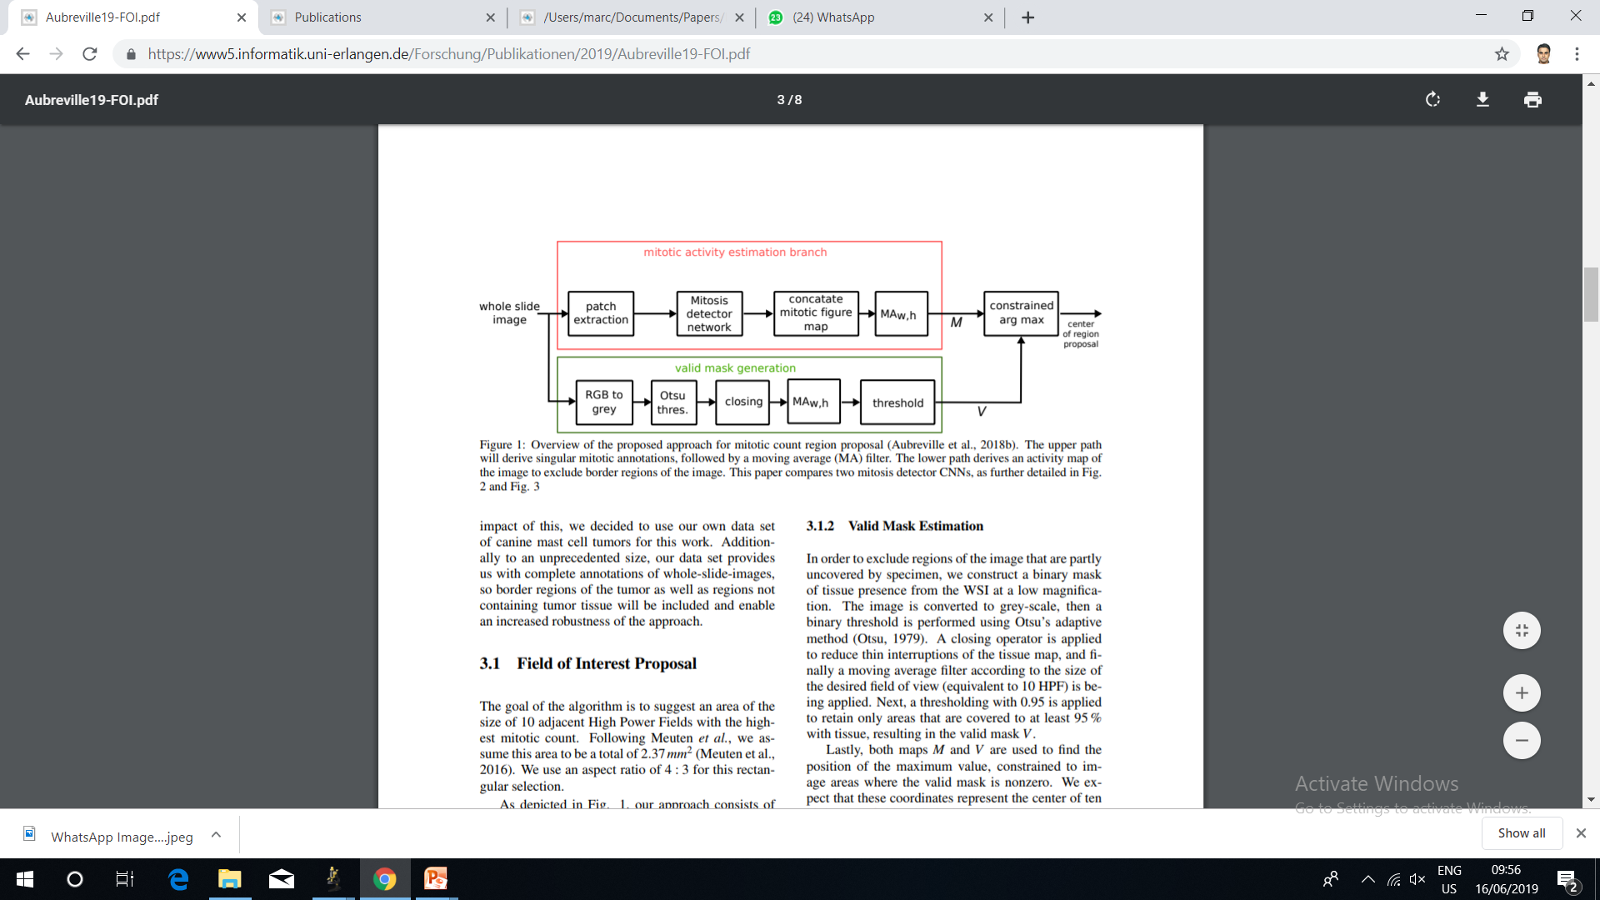
Mitosis Detection with Deep Learning

Slide 9
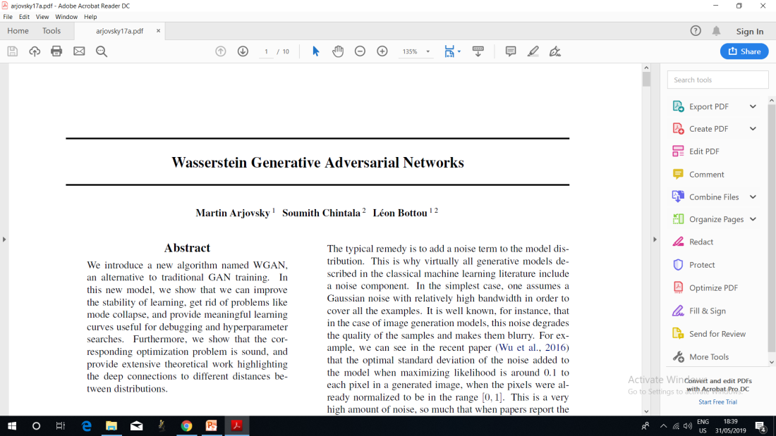
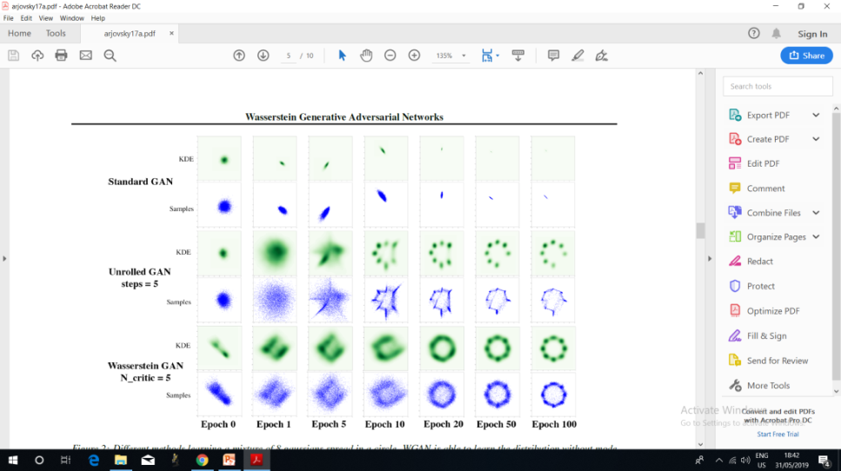
Literature Review
Key Notes:
Regular GAN like generator network and discriminator network.
Wasserstein Distance or EM Distance minimisation.(Usable gradient everywhere)
At different Epochs and checkpoints we can save different models with Tensor flow.
The loss decreases quickly and sample quality increases as well.
Overcomes stability issues of GAN and lack of flexibility of VAE.(No mode collapse)

Slide 10
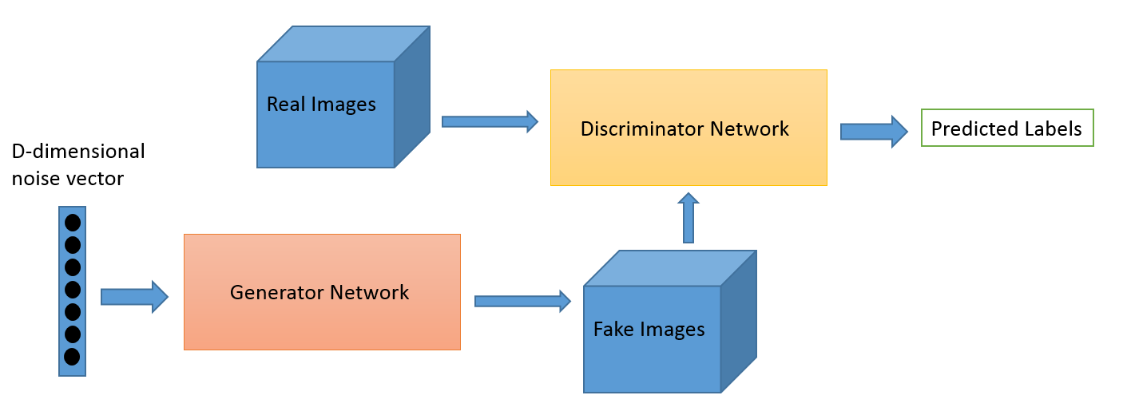
https://skymind.ai/wiki/generative-adversarial-network-gan

Slide 11
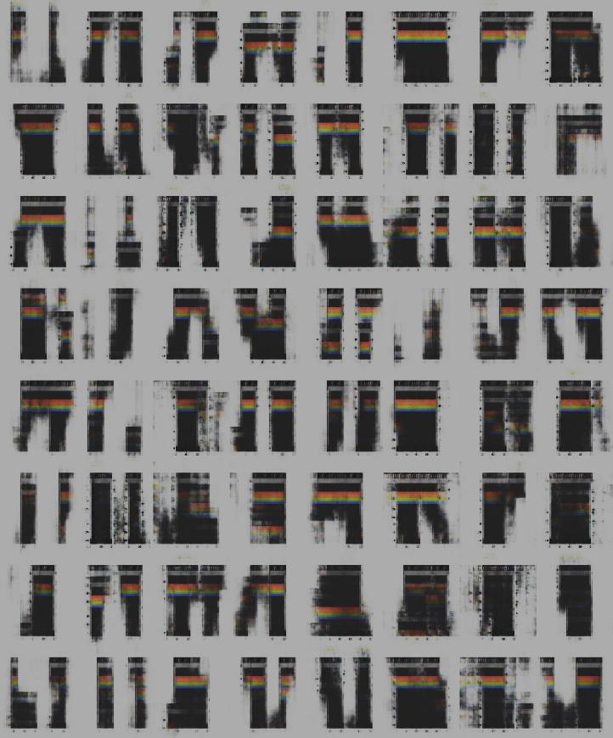
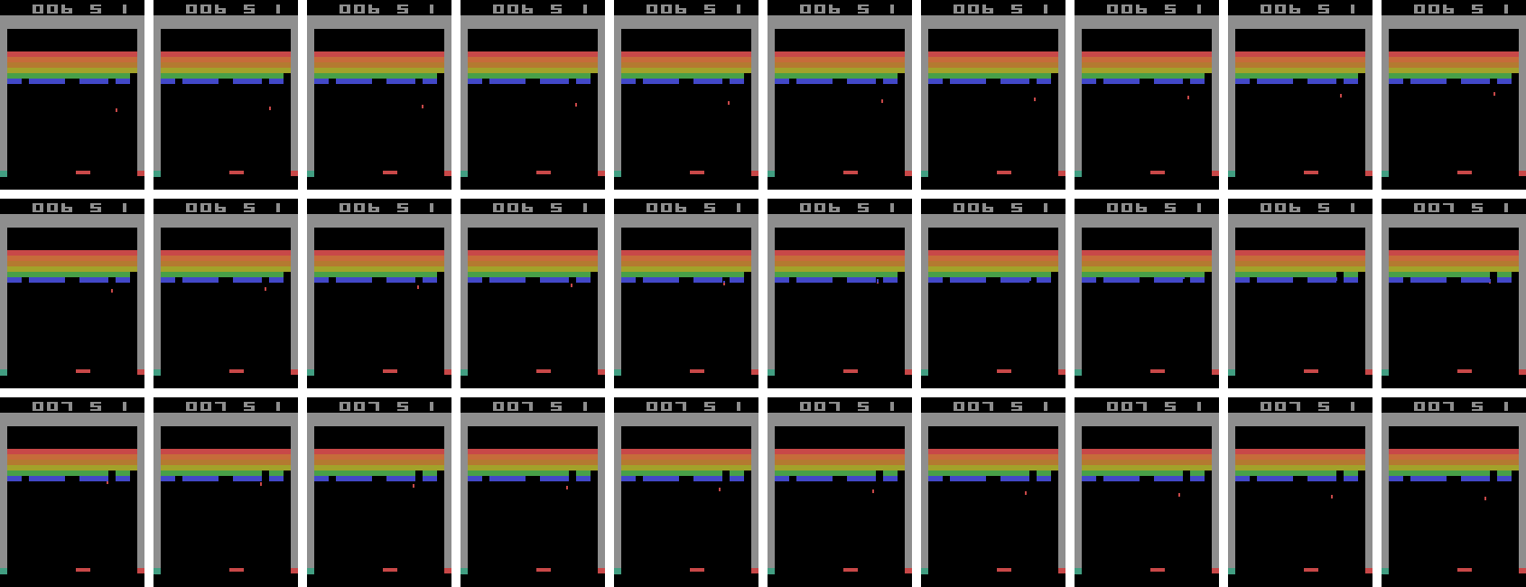
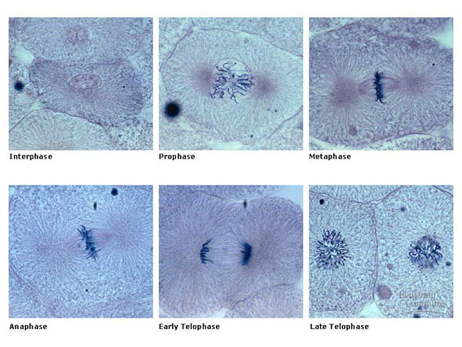
Epoch:3200-CPU
http://fig.cox.miami.edu/~cmallery/150/mitosis/mitosis.htm
https://danieltakeshi.github.io/2016/11/25/frame-skipping-and-preprocessing-for-deep-q-networks-on-atari-2600-games/

Slide 12
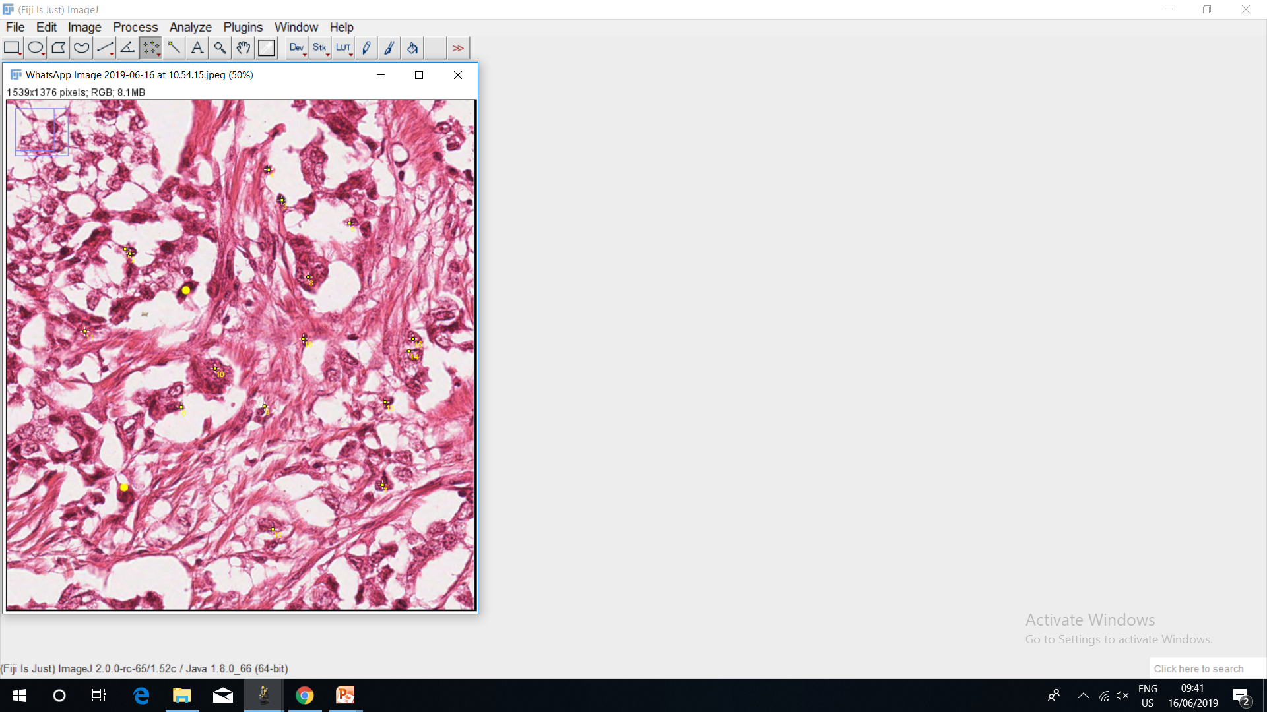

Slide 13



Level 1
“Tinder”Swipe
Training the players to learn about Mitotic Images
Annotated images. Accuracy should be greater than k to go the next level.

Slide 14

Level 2
Annotate each cell in the image by a simple tap.
Annotated images. Accuracy should be greater than k to go the next level.

Slide 15







Level 3
Make the rabbit jump on the mitotic cell. Then the rabbit burrows and gets a carrot or drowns if it jumps in the black area.

Slide 16
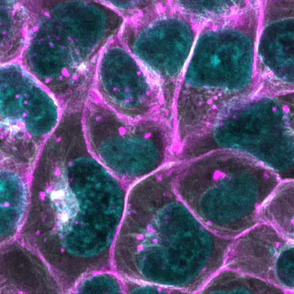
Scoring System
——Stage1. Introduction
Notes:
For this part, we present a short video and some pictures explaining the different stages of mitosis,

Slide 17
Scoring System
——Stage1. Introduction

Slide 18
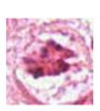
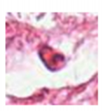
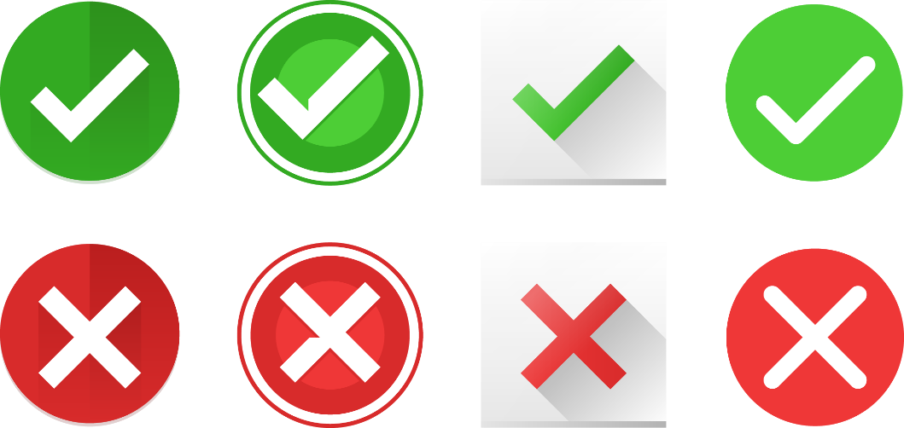

Scoring System
——Stage2. Primary Stage
Notes:
In this stage, we crop mitosis and non-mitosis cells from annotated data set. The users have to make quick decisions during this stage. To evaluate the performance of the users, a time bar is included in this stage. The time bar is initialized with 60 seconds. Every time the users have made a right decision, a small amount of time, for example, 0.1 second is added to the time bar. If they made a wrong choice, the game stops, and the player has to start again. Finally, the score is computed by the number of right decisions the user has made. For level up, the user has to reach a score bigger than 20.

Slide 19
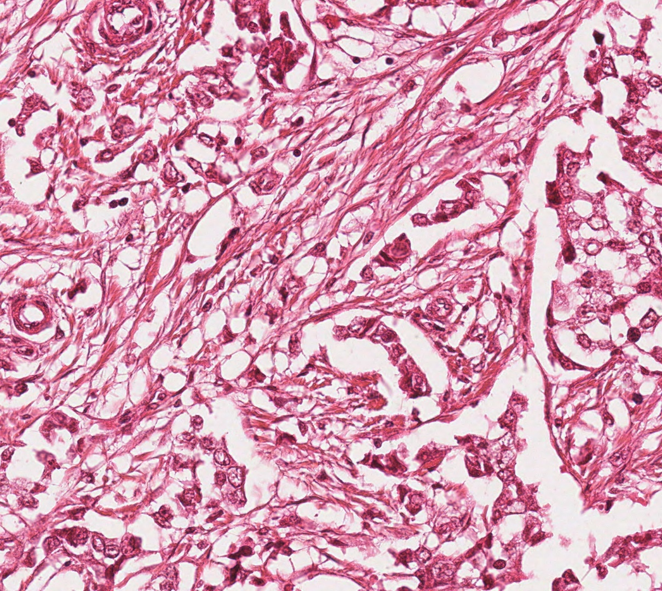
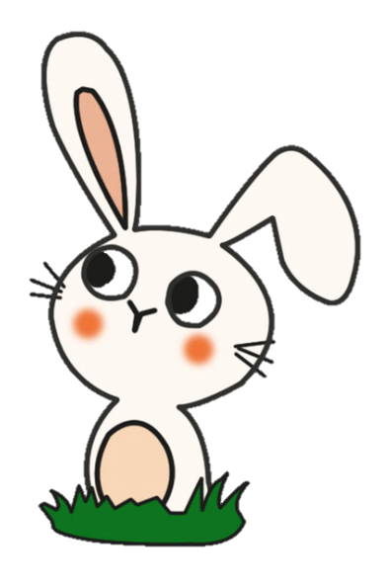
Scoring System
——Stage3. Intermediate Stage
Find the Carrot!
Notes:
In this stage, full frame of annotated images would be given. The task is to find out all the mitosis cells in the picture. The user could use hints when having difficulties finding out mitosis cells. And each hint will cost 5 carrots.

Slide 20
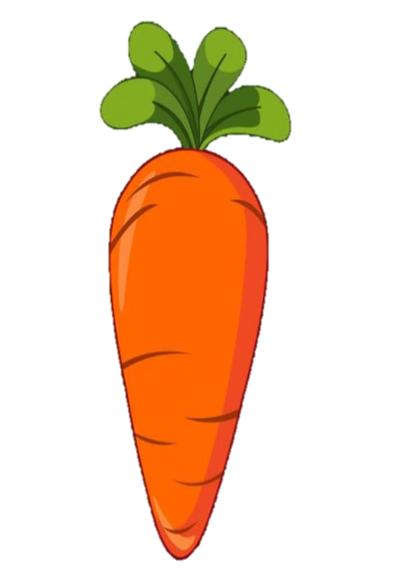
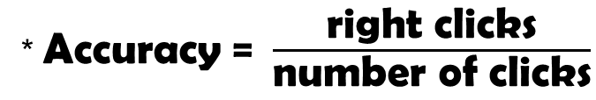
Scoring System
——Stage3. Intermediate Stage
Foundation Reward
× （1+Accuracy）
* Accuracy =$\frac{\text{right} \text{clicks}}{\text{number} \text{of} \text{clicks}}$
Notes:
After finishing annotation work for one image, the users would earn a reward computed based on their accuracy of clicks. And we also compute the moving average of the accuracy of the user as the evaluation of user performance. To reach a higher level, this moving average accuracy should reach a certain threshold.

Slide 21
Scoring System
——Stage4. Advanced Stage
Players get certain number of unannotated data during the season
Players get stable rewards after completing annotation of an image
After the season, compute the labeling result by majority voting and user ranking
Users get additional reward based on their ranking

Slide 22
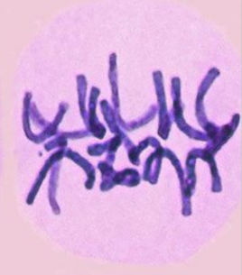
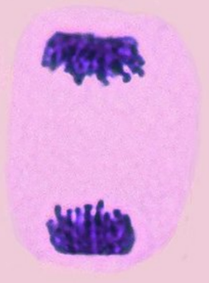
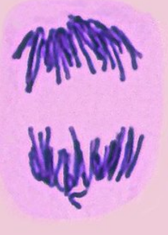
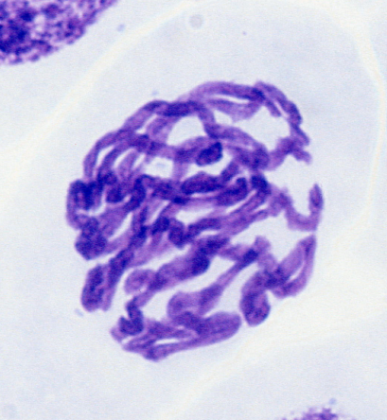

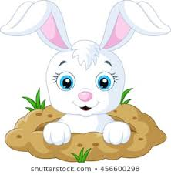
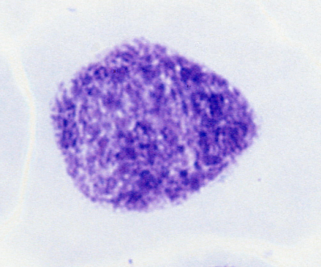
Labeling
Positive
(Low Positive)
Negative

Slide 23

Labeling
Name | X | Y | Hight | Width
1.jpg | 1200 | 960 | 1500 | 1800
position of the cell

Slide 24
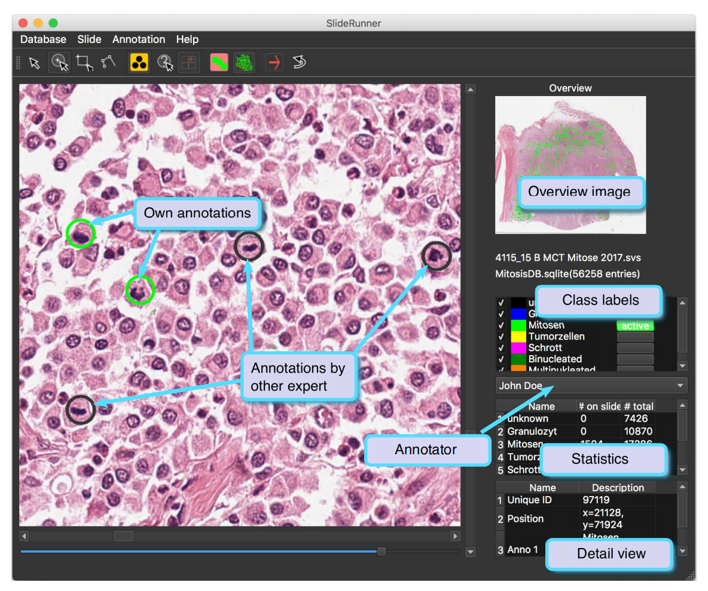
Labeling
SlideRunner - A Tool for Massive Cell Annotations in Whole Slide Images. Marc Aubreville, Christof Bertram

Slide 25
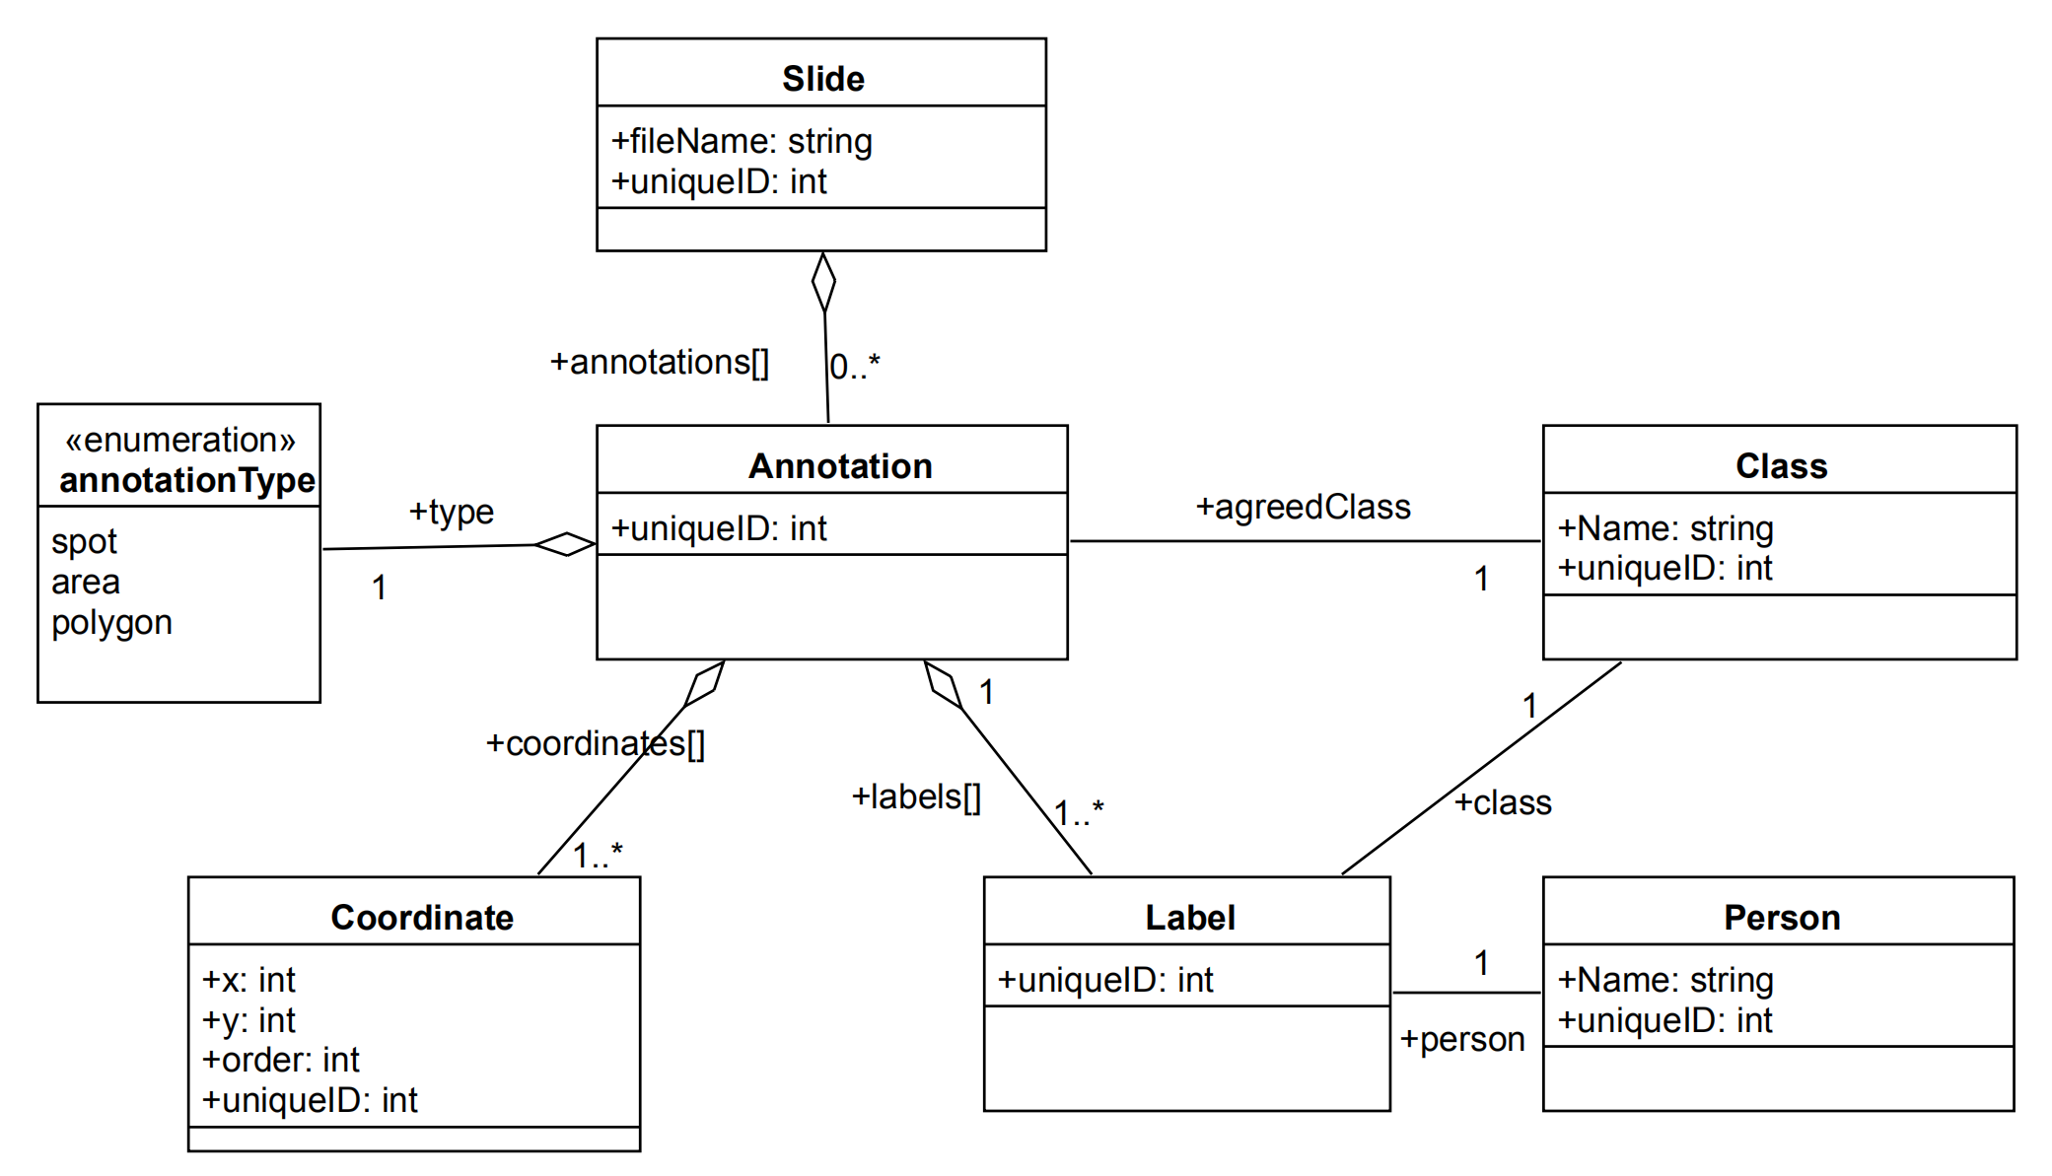
Labeling
SlideRunner - A Tool for Massive Cell Annotations in Whole Slide Images. Marc Aubreville, Christof Bertram

Slide 26
Important Parameters
minimum accuracy: ensures each contributor must maintain minimum 80%(or higher) accuracy on test questions throughout the job completion.
minimum or average time per task: ensures each contributor must spend a minimum of 10 seconds to complete one task.
maximum number of judgments per contributor: enable more contributors to participate in the job.
trust score: minimum number of images (20) for the contributor to review in work mode prior to computing a trust score for each contributor and prior to filtering contributors based on their trust score.
labels to collect per image(not sure if segmentation is better)
Crowdsourcing scoring of immunohistochemistry images: Evaluating Performance of the Crowd and an Automated Computational Method

Slide 27
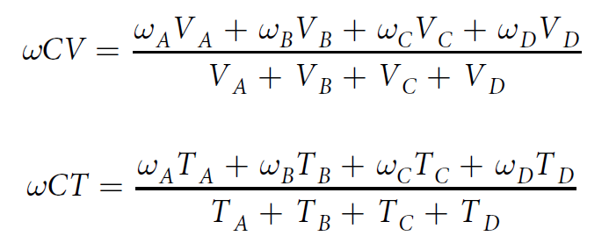
Aggregation Methods
maximum crowd votes (CV): computed by summing the votes for each label and selecting the label with the maximum number of votes as the aggregated label.
maximum crowd trust scores (CT): computed by summing the contributor trust score (CT) for each label and selecting the label with the maximum trust score as the aggregated label.
maximumweighted crowd votes (ωCV)
maximum weighted crowd trust scores (ωCT)

Slide 28
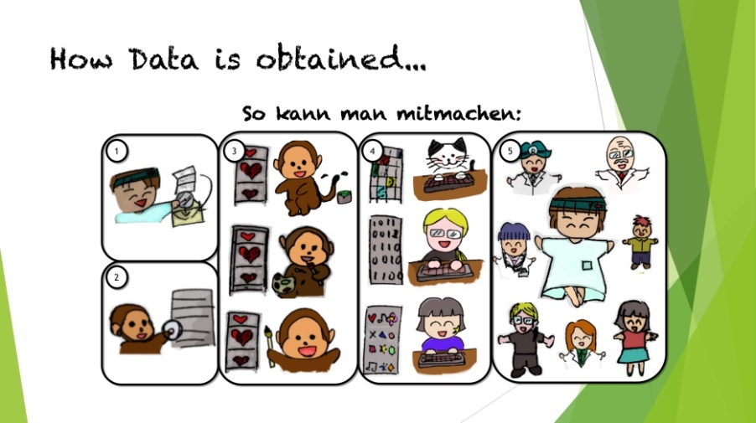
Conclusion:

Slide 29
Q&A and Feedback
THANK YOU!!!

